Slide 1
7- Linting Python Code

Slide 2
Context
Linting in action
Ex.1 – "syntax-error“ 3
Hover mouse over red underline 4
fix issues 5
Ex.2 – “invalid syntax“ 6
Hover mouse over red underline 7
Problem panel 8
fix issues 12
Command Palette 13
“lint” command 15

Slide 3


Ex.1 – "syntax-error“
bellow code is :
Valid python code for python 2
Invalid python code from python 3’s point of view
when I save the changes you can see this red underline here.

Slide 4
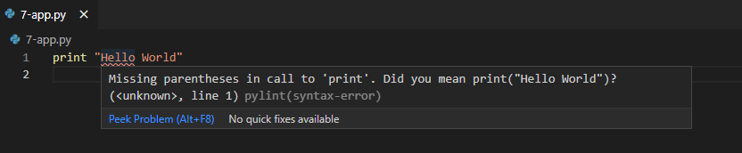
Hover mouse over red underline
We can see this tool tip it's coming from pylint and here's the error message. so this is the benefit of linting.
you're writing code you can see potential problems in your code,
you don't have to wait to run your program to see these errors.

Slide 5

fix issues
you can see that red underline is gone.

Slide 6


Ex.2 – “invalid syntax“
save the changes
Earlier we ran this code in python interpreters interactive shell.
There we got a syntax or grammar error.

Slide 7

Hover mouse over red underline
you can see pylint is telling us this is invalid syntax or invalid grammar, it's like an incomplete sentence.

Slide 8
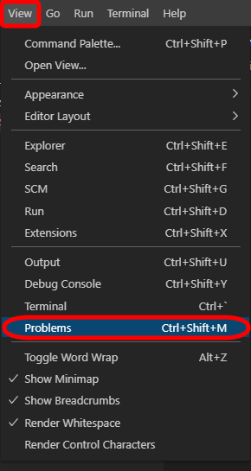
Problem panel
this problems panel lists all the issues in your code in one place.
So if you have an application with multiple files this is really useful because some of those files may not currently be open, so this linter pylint will analyze all your files and if it finds any issues it will list them here in the problems panel.

Slide 9
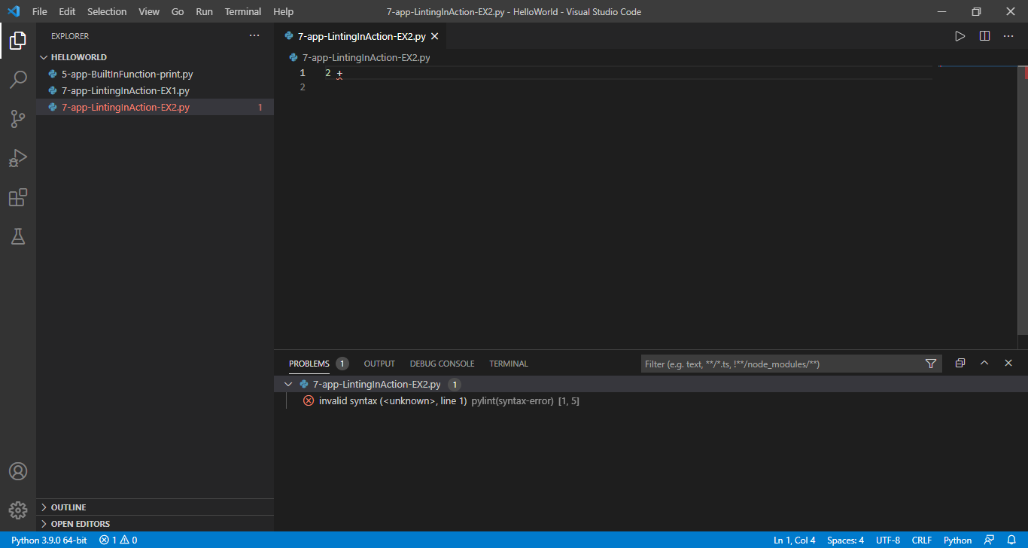

Slide 10
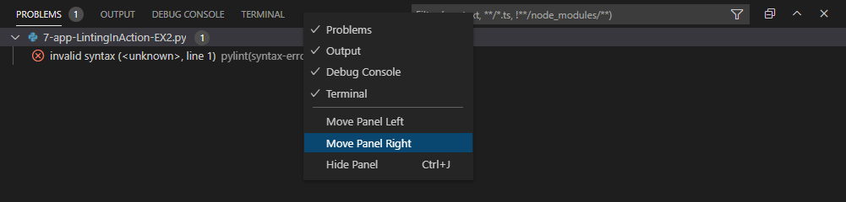
Now you can also put this
on the right side of the screen, right click on the problems panel tab and choose move to right
so as you write code these problems will occur here.

Slide 11
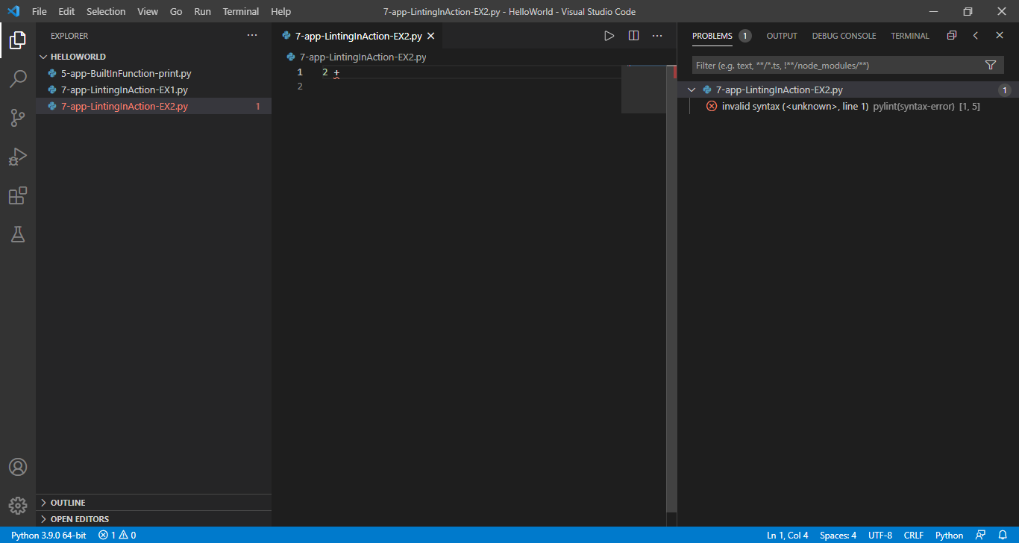

Slide 12
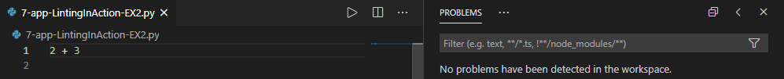
fix issues
Add 3 like bellow
Save changes
And you can see the problem disappear

Slide 13
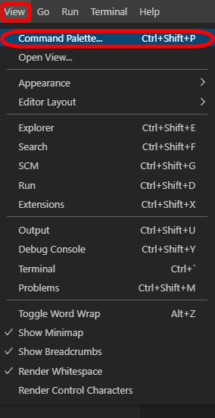
This is a very important feature in vs code

Slide 14
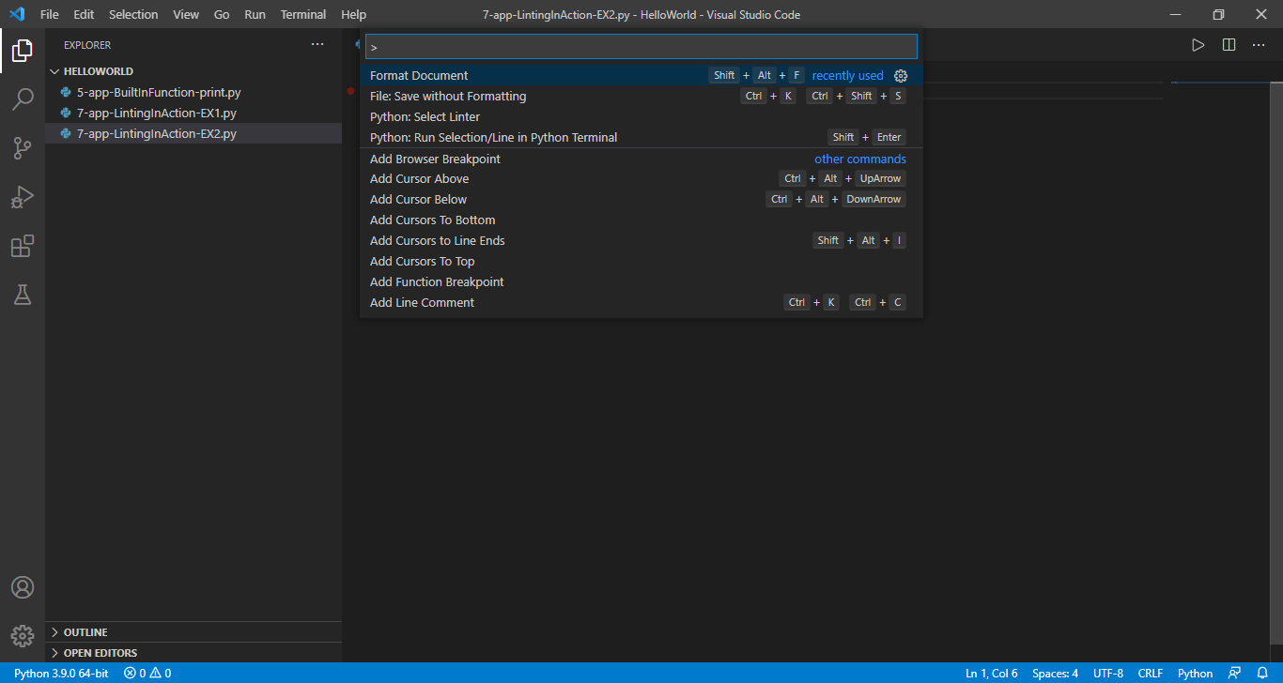
With this command palette you can execute various commands in VSCode

Slide 15
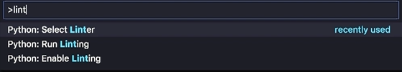
lint
If you type lint here, you can see all commands related to linting.
As you can see all these commands are prefixed with python
because these commands come with the python extension that we installed earlier So these are additional features available to us in vs code. The first command is select linter.
Click on select linter

Slide 16
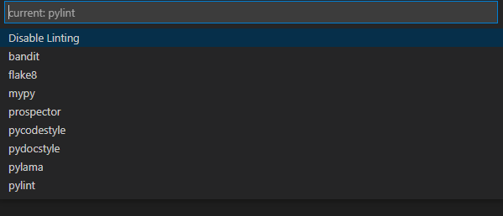
In this list you can see various linters available for pylint
Different developers prefer different linters

Slide 17
I personally prefer pylint, that is the most popular one,
and that is the default linter set in the python extension of vs code
the difference between these linters is
in how they find and report errors.
Some error messages are more meaningful or more friendly,
others are more ambiguous. So that's all about linting.

